Slide 1
Medical Insurance Premium Prediction

Slide 2

صباح الجمال والكريستال

Slide 3
Table of contents
01
03
02
04
Introduction
Data visualization
Let’s take alook about this medical data
OMG!look at these graphs
discuss
finally
How can the information from this data help us
If any one has questions

Slide 4
01
Introduction

Slide 5
Introduction
Introduction
A Medical Insurance Company Has Released Data For Almost 1000 Customers. A Model That Predicts The Yearly Medical Cover Cost. The Data Is Voluntarily Given By Customers.
The Dataset Contains Health Related Parameters Of The Customers. This dataset consists of 987 rows and 11 columns .
We will make data analysis and data visualization process

Slide 6
Goals
01
we want to extract data from this file
02
Analysis this data and visualize it
03
The graphs will help us to understand some terms and predict

Slide 7
Methods
Observation
Study and Sampling
Data Collect
visualization
Report

Slide 8
02
discuss

Slide 9
In general how can the medical data help us to improve the health

Slide 10
03
Data visualization

Slide 11
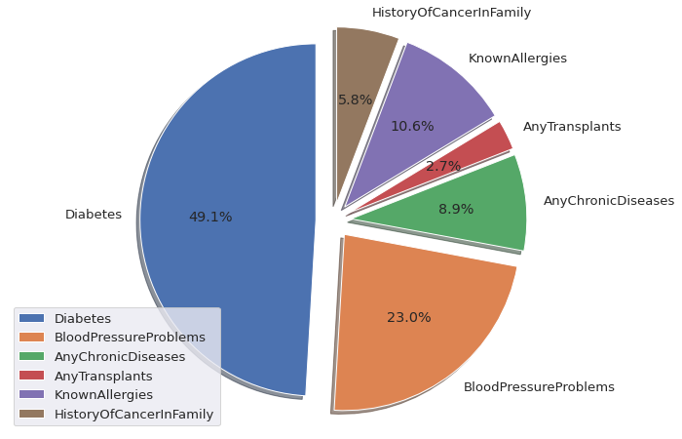
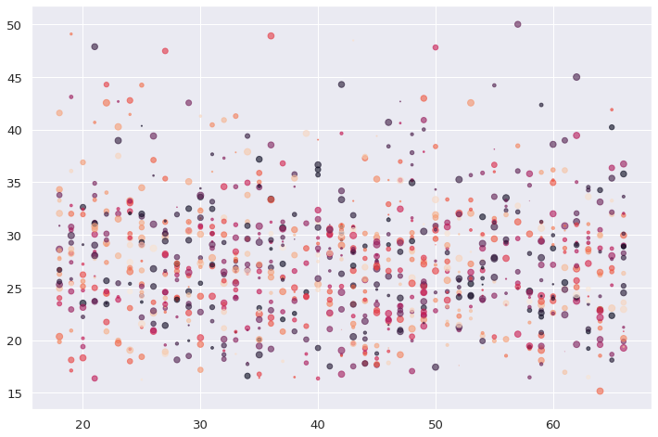
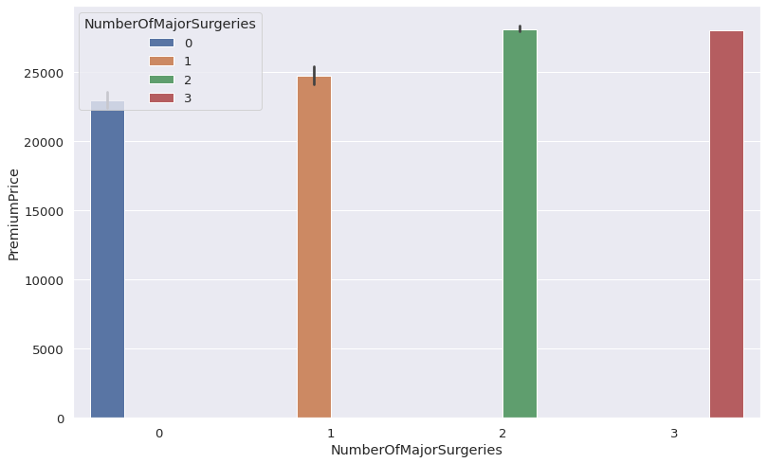
Background

Slide 12
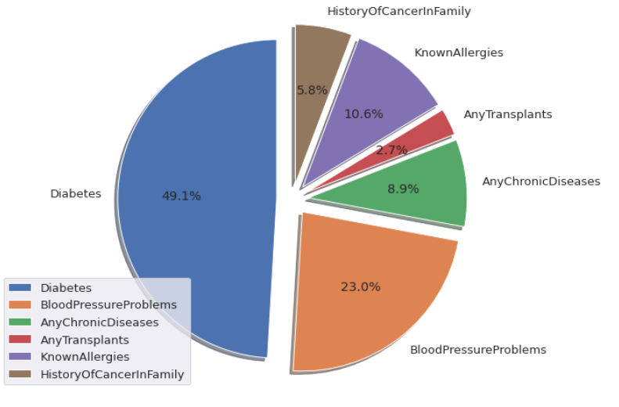
All data diseases

Slide 13
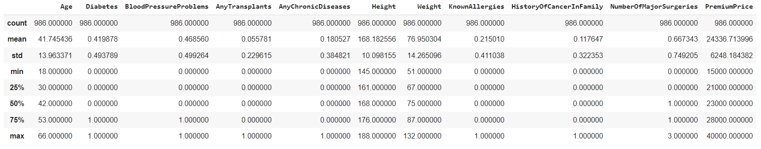
Data Description

Slide 14
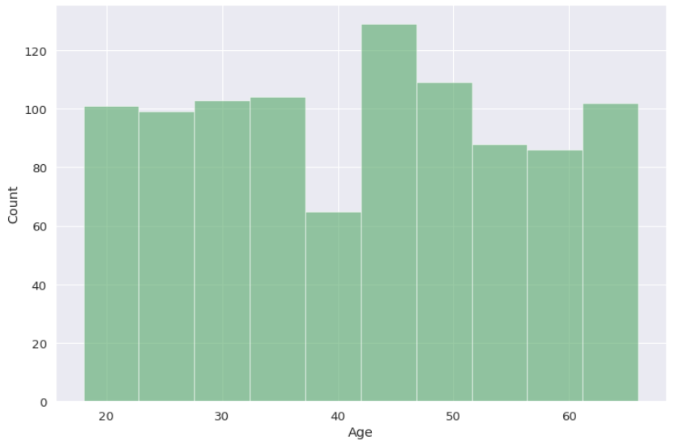
Average of Ages we have

Slide 15
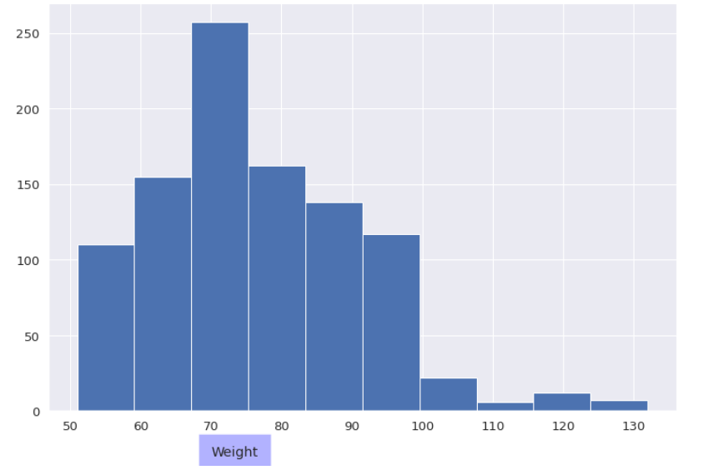
Data weights

Slide 16
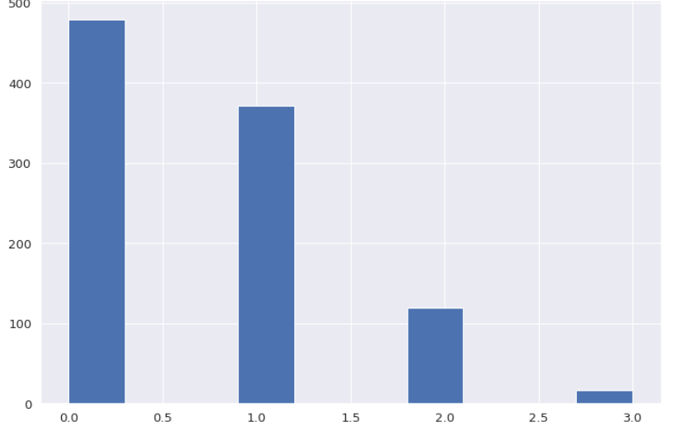
The number of people
who underwent surgery.

Slide 17
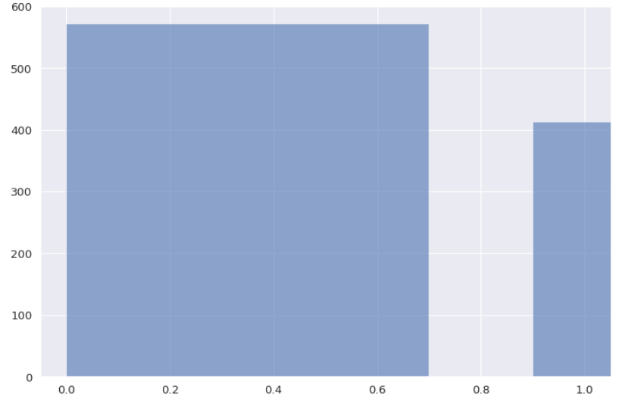
Number of people who have
Diabetes?

Slide 18
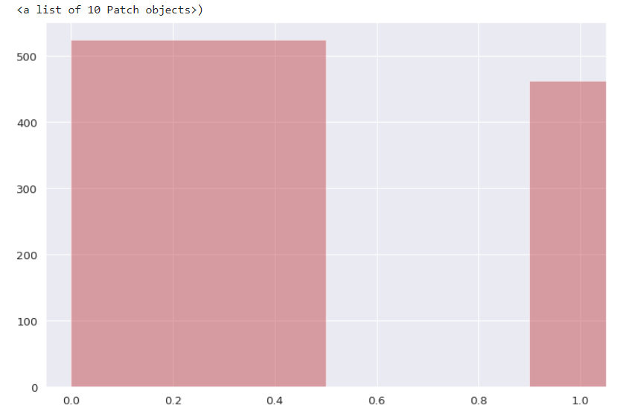
Number of people who have
Blood Pressure Problems

Slide 19
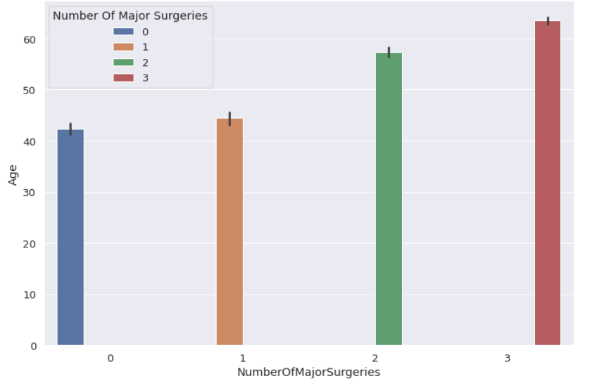
The number of surgeries over the age of 25

Slide 20
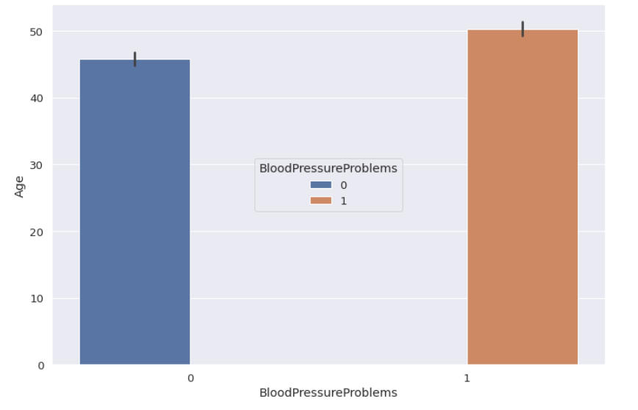
Blood Pressure problems over 30

Slide 21
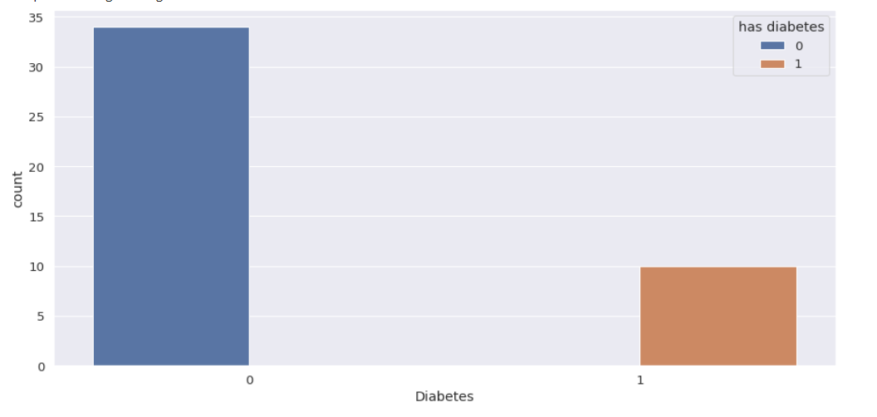
How many people have diabetes under the age of 20

Slide 22
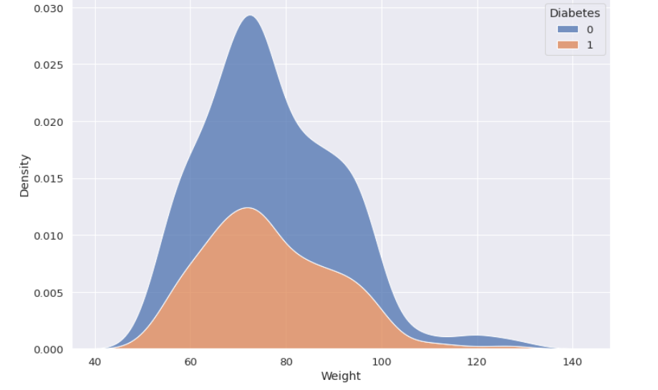
Relationship between weight and diabetes

Slide 23
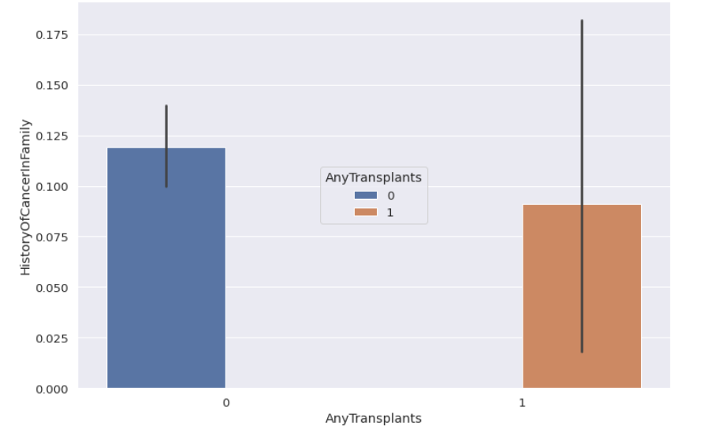
Relationship between transplants and the presence of cancer in the family

Slide 24
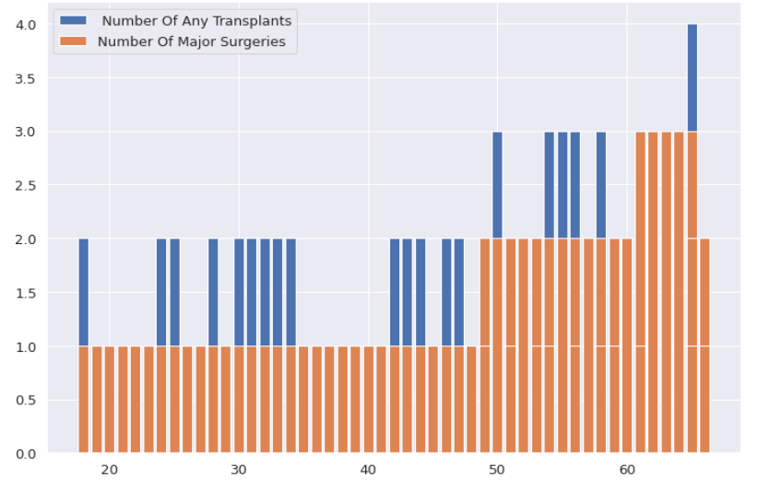

Slide 25
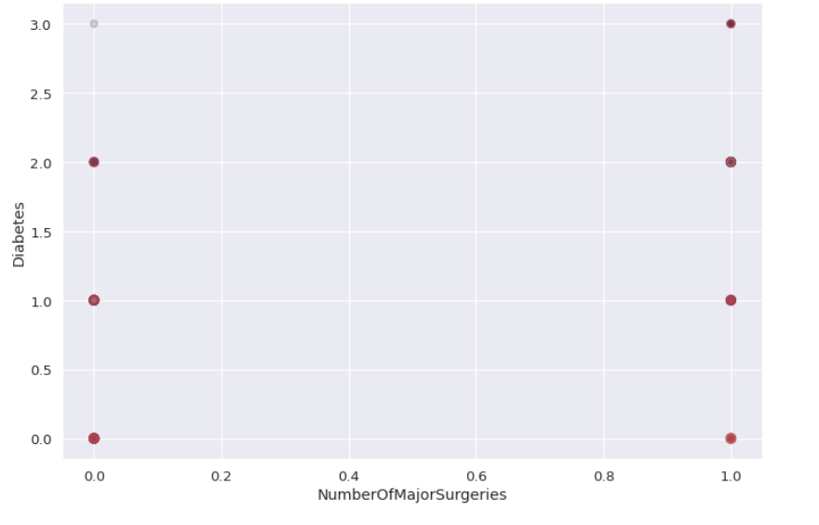
Percentage of the number of Major Surgeries for diabetic patients

Slide 26
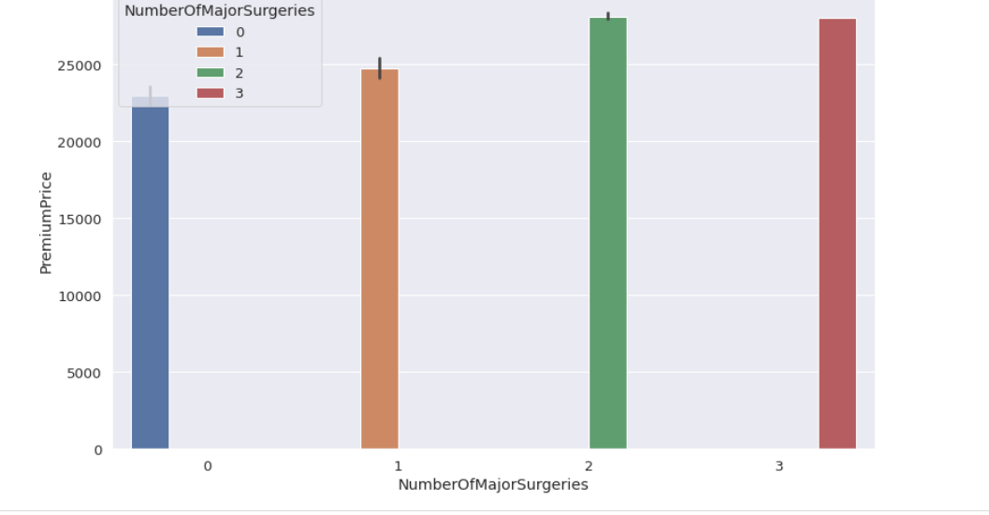
Effect of surgeries on premuim price

Slide 27
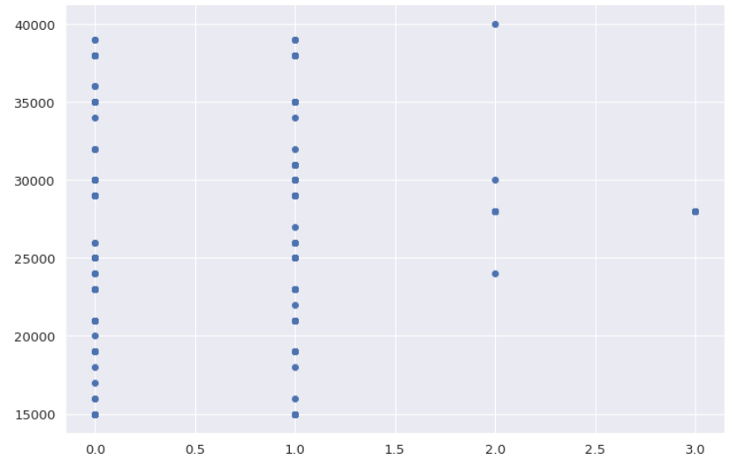
The Relation between Number Of Major Surgeries and Premium Price

Slide 28
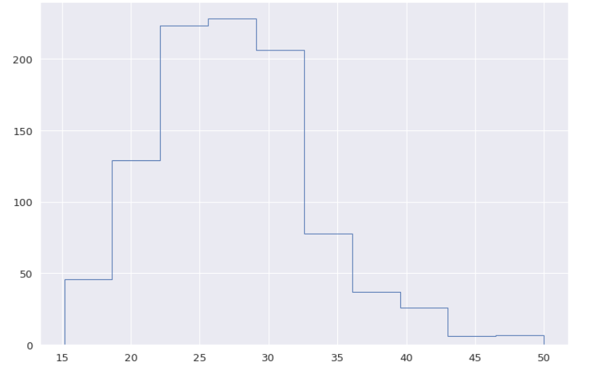
w/((h/100)**2
Is the weight proportional to the height or is there an increase in weight ,which leads to an increase in diseases?

Slide 29
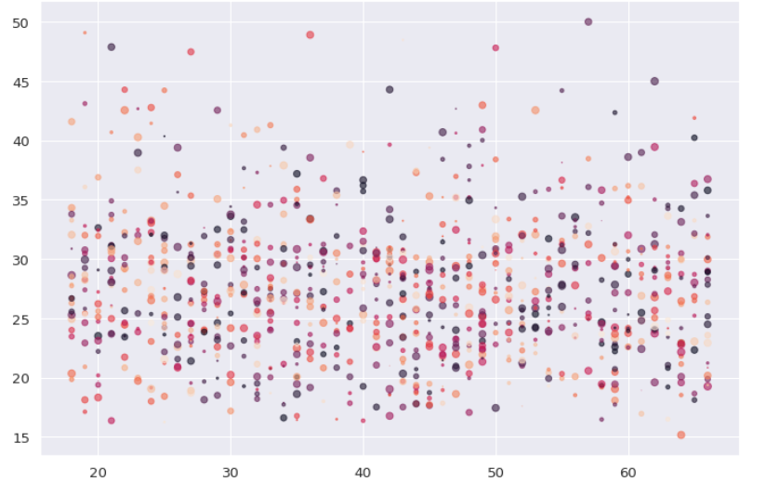
Ratio

Slide 30
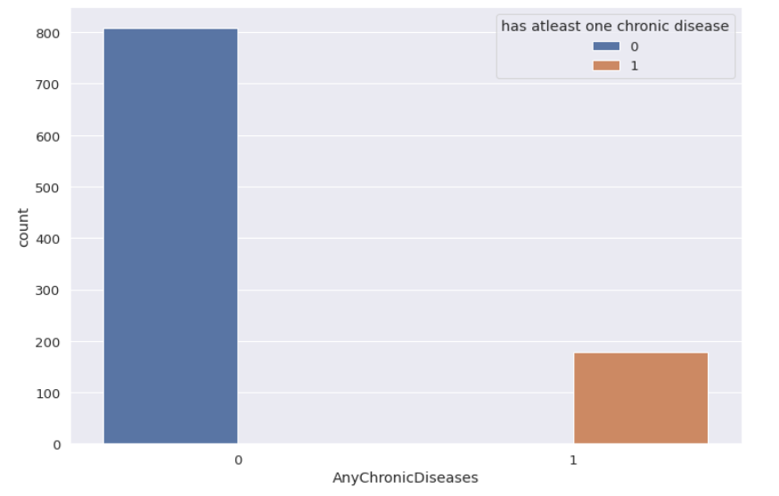
How many people have at least one chronic disease?

Slide 31



Team Members
Omnia
Salma
Eman

Slide 32


Thanks
ربنا يحفظنا بجد انا مبهور بينا

